Slide 1
Infection, Injection, And A Test
PNSFA
April 22, 2021 John W. Mitchell

Slide 2
April 2021
Year Two of Pandemic-Year One of Upturn
External Shock and Policy Induced Recession-Right after Last Year’s Event
Global Vaccination Effort
A Behavioral Shift-The Full Dimensions of Which are Unclear
A Massive Fiscal and Monetary Policy Response that Continues
From Demand Concerns to Supply Issues-Chips, Lumber, Rubber, Labor ?
A Confluence of Upside Forces-Robust Data
An Altered Cast of Characters-Some Old and Some New
Stimmies joins the Lexicon
Time of Weird Comparisons

Slide 3
REAL GDP Growth (SAAR)
Consumption Contribution -24% Points in Q2, 25.44% Points Q3 , and 1.58% Points in Q4
Housing -1.6% Points in Q2, 2.19% Points in Q3, and 1.39% Points in Q4
Private Investment -8.77 % Points in Q2, 11.96% Points in Q3, and 4.41% Points in Q4

Slide 4
Employment Month to Month Changes
April Lost a Decade’s Job Growth
May to November Up then -306,000 in December, January up 233,000, February up 468,000. March up 916,000
Leisure and Hospitality fell 498,000 in December, and 17,000 in January before rising 384,000 in Feb. and 280,000 in March
Unemployment Rate 6% in March
6.9 Million not in Labor Force But Want Job, Part Time Economic Reasons 5.8 Million
Participation Rate 61.5% March versus 63.3% February 20
Beige Book-Hiring Difficulties and Unemployment Benefits
40% Private Job Losses in Leisure and Hospitality (Brainard)
8.4 Million Below Peak

Slide 5
Annual Change CPI 2020-21 March 2021 2.6% Feb. PCE 1.6%
Fed Target 2% Since 2012-PCE
Watch for Transitory Shocks-Base Effect
Supply Chain Disruptions-Shipping Capacity, Covid Restrictions, Trade Barriers, Chips, Lumber
Debate about Inflation Risk? Many on the Call Probably do not Remember the Last Episode!
Transitory or Ingrained in Expectations
PPI Final Demand up 1% in March
Steel Mill Products 40.1% YOY, Primary Non-Ferrous Metals 28.3% March

Slide 6
The Response: Monetary Policy Back to the Zero Bound and FAIT
Fed cut Funds Rate Twice in March 2020-Back to Zero Bound
Broad Liquidity Support
Now Buying $120 Billion Per Month in Govt. Securities
Security Holdings up about $3 Trillion in the Last Year
Rate Projections- Here until 2023
Recent Jump in Bond Yields 10 Year from .93% First Business Day of Year and to 1.59% April 16th
New Operating Procedure-Tolerate Inflation above 2% after Period of Below Target (FAIT)
Governor Lael Brainard “patient rather than preemptive” policy

Slide 7
Fiscal Policy Unaccustomed Speed
Six Corona Virus Bills Passed and Signed: Stimulus Checks, Forgivable Loans, Boosted Unemployment Compensation, Help to Hospitals, States and Cities, Testing Funds, Expanded Sick Leave etc.
About $6 Trillion in New Spending Including the $1.9 Trillion
In Fiscal 2020-The Deficit hit $3.1 Trillion with Spending up 47% to $6.5 Trillion and Revenues Down 1% to $3.4 Trillion- 16.1% of GDP Highest Since 1945
March 2021 Revenues up 13%-Spending up 161% compared to March 2020
Another $2.3 Trillion Plan Unveiled-$620 Billion Transportation, $400 Billion Care for Disabled and Elderly, $300 Billion for Manufacturing, Broadband, Power Grid, Remove Lead Pipes- Raise Corporate Income Taxes back to 28% from 21%-Change International Rules- Fate Unclear

Slide 8
Fiscal Policy In Action In An Income Tax Reliant State (%,SAAR, BEA)
 | Personal Income | Earnings | Transfers
US Q2 | 35.8 | -24.8 | 847.4
Q3 | -11.3 | 28.5 | -64.9
Q4 | -6.8 | 6.2 | -43.1
Oregon Q2 | 44 | -23.8 | 814.1
Q3 | -14.8 | 23 | -62.9
Q4 | -9.3 | 4.6 | -43.9
Washington Q2 | 32.9 | -19 | 998.5
Q3 | -9.2 | 32.9 | -71.7
Q4 | -6.2 | 3.1 | -44.9

Slide 9
American Rescue Plan $1.9 Trillion
$1,400 Payments to People Making Less $75,000 or $150,000 Couples and Kids
Higher and Extended Unemployment Payments
Rental Assistance
Vaccine Distribution
Funds for State and Local Governments, Schools, Pension Bail Outs
Refundable Child Tax Credits-Major Anti-Poverty Program
Higher Premium Subsidies for ACA-No More than 8.5% of Income down from 10% Now

Slide 10
A Grand Experiment
Modern Monetary Theory-Spend What Need To In Order to Achieve Goals
We Create the Money so Bankruptcy has no Meaning
The Deficit Worries Have not Come to Pass-Crowding Out, Rising Rates, High Inflation, Inability to Sell Debt
Tighten When Press Capacity and Inflation Appears
Grow Out of the Debt-as after the Second World War
Reflect on Recent Events- How much Discussion of How to Pay For or Long Term Implications of Actions?

Slide 11
Macro Thoughts
Note the Recent Rate Increases-Expectations of Faster Growth, Inflation Concerns, Pressure of More Borrowing
How Much Slack is Out There $900 Billion Below Trent Prior to Pandemic-Spending $1.9 Trillion on top of $900 Billion in late December and $2.3 Trillion Proposed?
Inflation has Been a no Show In spite of Earlier Worries and Tight Labor Markets in 2018-Early 2020
Go Big rather than Small as after the Great Recession
Deficit Fears have Been Wrong to Date But?
Asset Values and Rising Rates
Tax Incidence ?

Slide 12
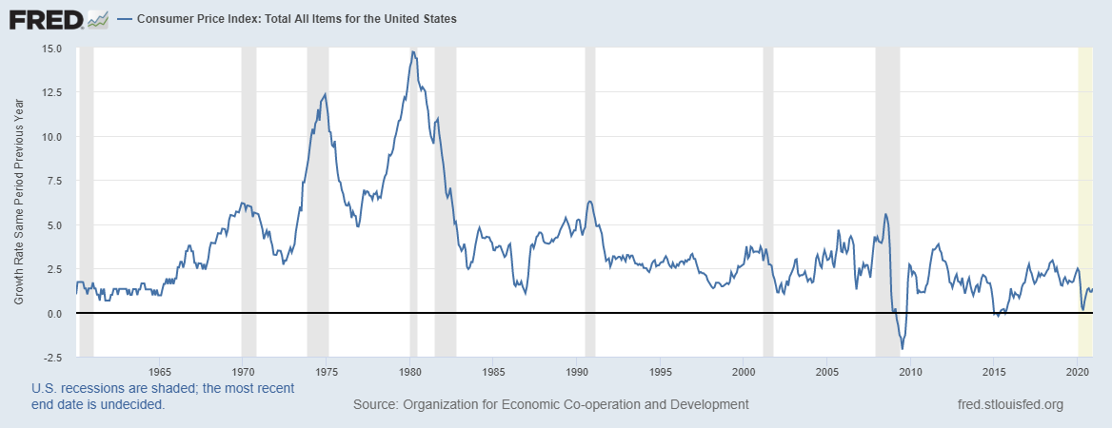
Back to the Future? Risk?
Amity Shlaes “The Great Society”
Money Supply School
Fiscal Expansionary Policy
Tightening Labor Markets
New Operating Policy at Fed
So Far Anchored Expectations

Slide 13
Upside Confluence 2021 A Boomer Year
Vaccine Distribution and Effectiveness
Fiscal Stimulus and Monetary Policy
Money Supply Growth
Savings Build Up-January Savings Rate 19.8% and 13.6% in February- in 2019 7.5%--More Funds Being Distributed
Net Worth Jump $6.93 Trillion in Q4-Households and Non-Profits
Pent Up Demand -The 20’s and after the Black Plague

Slide 14
Housing/Construction
FHFA Q4 House Price Index-All States Up: Idaho 21.08%, WA 13.7%, Oregon 11.54%
Purchase Only Q4 1.Boise 23.42%, 2. Tacoma 16.27%, 10. Seattle 13.97%, 71. Portland 10%
Case-Shiller January Portland 10.6%, Seattle 14.3%
Low Levels of Inventory, Strong Demand, Mortgage Rates, Preferences, Demographics-Millennials in Home Buying Demographic, Pandemic Distortions, Lock Downs, Stay Put, Supply Chain Pressures
Strength Expected to Continue in 2021
Affordability Limits-Have had Falling Mortgage Rates and Rising Prices-That Ship Sailed
To February Value Put in Place- Residential up 22%, Non-Res -6.9%
Beige Book-April-Hotel, Office, Retail Weak

Slide 15
The Region
Above Average Population Growth in 2019-2020 OR .6%, WA 1%, US .35%
Personal Income Growth 2019-20 Oregon 7.3%, Washington 6.6% US 6.1%
Both States Still Have Employment Below the Previous Year
Portland become Poster Child for Urban Disorder
Both States Share the National Strength in the Home Prices
No Longer at the top of the Employment Growth Lists

Slide 16
Job Growth Update February 2021 Data Year over Year Change – 49 States Down Source: BLS, ASU
Idaho 1
Utah 2
South Dakota 3
Montana 4
Nebraska 5
Alabama 6
Arkansas 7
Tennessee 8
North Carolina 9
South Carolina 10
Mississippi 11
Arizona 12
Indiana 13
Georgia 14
Texas 15
Missouri 16
Virginia 17
Kansas 18
Iowa 19
Maine 20
Kentucky 21
Delaware 22
Colorado 23
Wyoming 24
Wisconsin 25
West Virginia 26
New Hampshire 27
Oklahoma 28
Ohio 29
Maryland 30
Washington31
Florida 32
North Dakota 33
Alaska 34
Minnesota 35
Connecticut 36
Pennsylvania 37
Illinois 38
Michigan 39
Oregon 40
Louisiana 41
New Jersey 42
Vermont 43
Massachusetts 44
Rhode Island 45
New Mexico 46
California 47
Nevada 48
New York 49
Hawaii 50

Slide 17
Oregon
Oregon Job Change February to April 2020 -13.8%
Monthly Change in Payroll Employment (SA)

Slide 18
Oregon March 2021 Down 6% YoY
Oregon Job Change April 2020 to March 2021 8.4%
February 2021 Metro Employment Change YoY
 | # | %
Albany | -3,070 | -6.6
Bend | -5,150 | -5.9
Corvallis | -4,540 | -10.3
Eugene | -17,400 | -10.5
Grants Pass | -780 | -2.9
Medford | -4,510 | -5
Portland | -103,700 | -8.4
Salem | -7,800 | -4.5

Slide 19
Washington
Washington Job Change February to April 2020 Down 10.9%
Monthly Change in Payroll Employment (SA)

Slide 20
Washington March 2021 Down 4.8% YoY
March 2021 Metro Employment Change YoY
Washington Job Change April 2020 to March 2021 6.6%
 | # | %
Bellingham | -6,300 | -6.5
Bremerton | -5,100 | -5.4
Olympia | -2,800 | -2.3
Seattle | -92,500 | -5.2
Skagit | -3,000 | -5.8
Spokane | -10,200 | -4
Tacoma | -19,800 | -5.2
Tri-Cities | -2,100 | -1.8
Wenatchee | -1,600 | -3.5
Yakima | -2,400 | -2.8

Slide 21
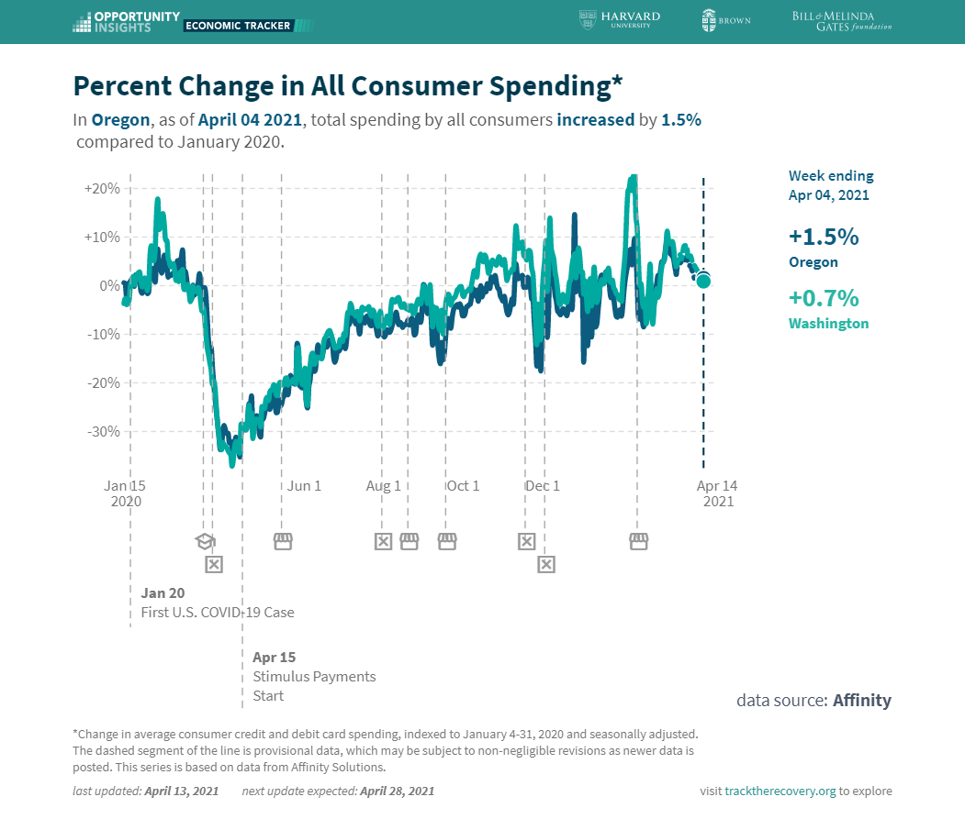
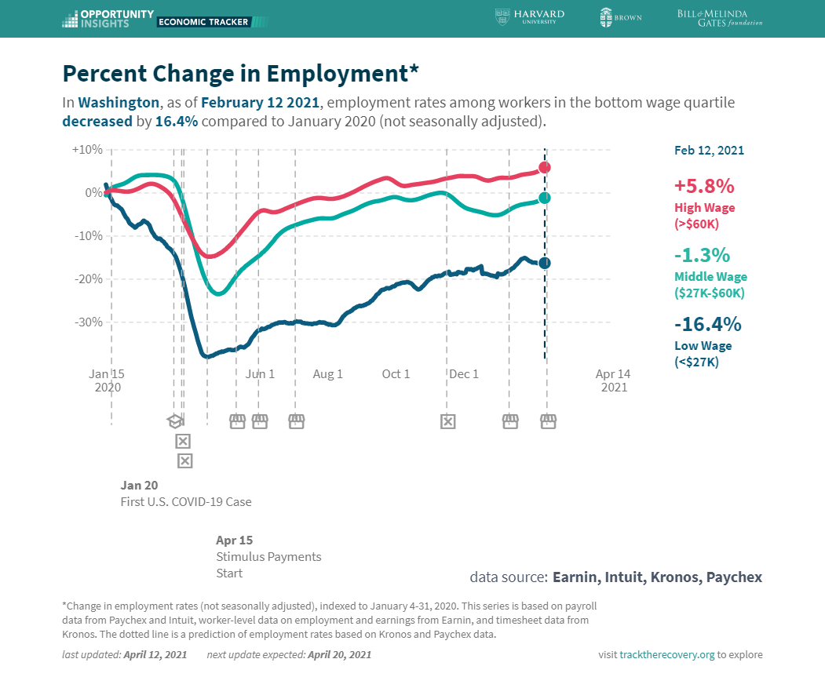
Opportunity Insights Chetty, Friedman, Hendren, Stepner
Consumer Spending
Washington
Opportunity Insights

Slide 22
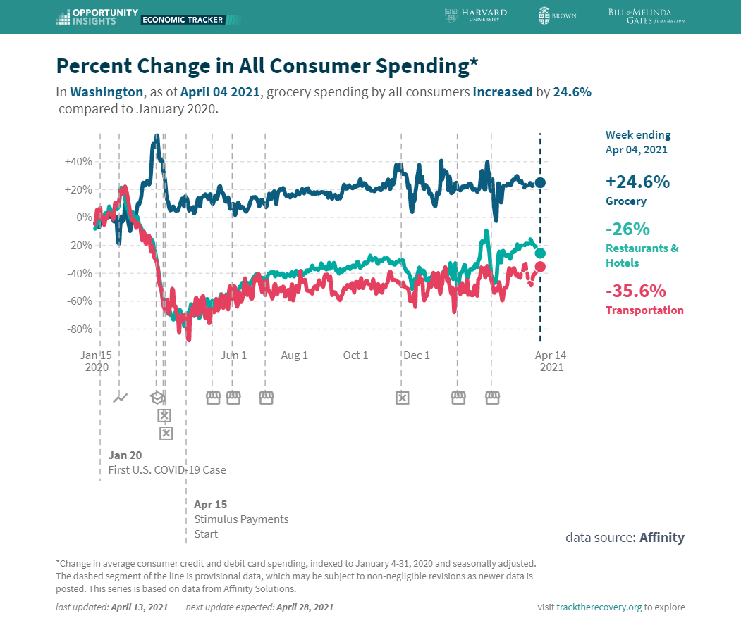
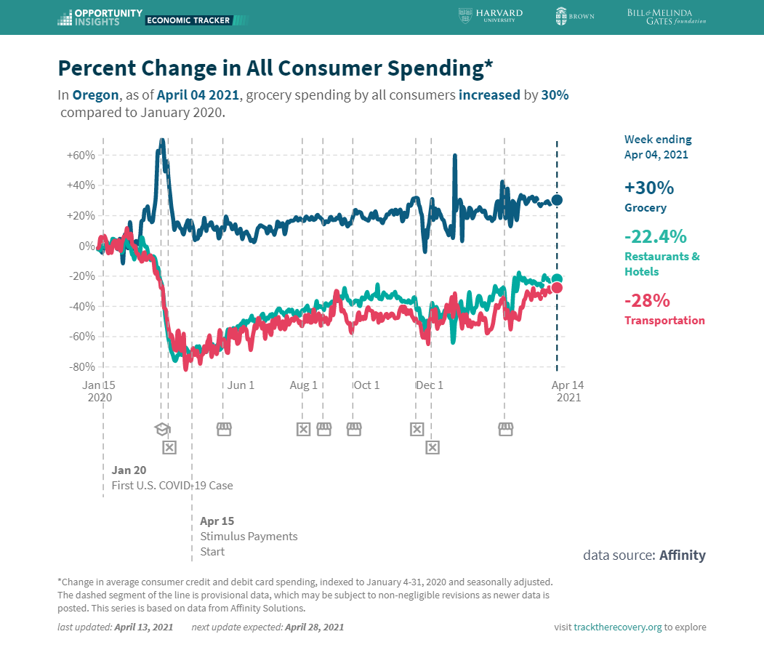
Opportunity Insights Chetty, Friedman, Hendren, Stepner

Slide 23
The Outlook The Recovery is Underway But The Trajectory is Uncertain
Expectations for 2021 5-7% Growth in GDP-Rates and Inflation Moving Up
Oregon Employment Growth at 1.4% in 2021 and 4.4% in 2022 State Forecast March WBC Oregon -3.3% in 2021 March
Washington Consensus is .4 in 2021 an 3% in 2022
The Annual Comparisons will get Better as the Year Goes On
But
Virus Course ? New Variants? A Fourth Wave?
Deferred Demand ?
Infrastructure Plan-Elements, Timing, Capacity?
Vaccination Program ? Census Pulse Survey OR 41.7%, WA 46.2% Adults Vaccinated Week 27
Behavior ?
Damage at this Point that is Invisible

Slide 24
The Pandemic as an Accelerant (A New Experience for US All)
Online Shopping
Regional Dispersion
Connectivity/Digital Divide
Digital Payments
Income Distribution Issues
Healthcare System
Vaccine Development
Productivity ?

Slide 25
The Long Shadow and Leftovers Of This Interlude
Plans Disrupted, Assumptions Changed, Range of Possibilities Widened
What business entities will survive? Deferrals, Forbearance, Eviction Moratoriums, Debt Burdens
Transitions-Jobs Gone, Firms Gone, Hysteresis
Education Disruption-Lifetime Implications, Poor Bear The Brunt, Declining Attendance
Participation Rates-Stay Home, Income and Experience Loss, Drop Out
Millions of People with Covid-19-The Long-Term impacts-Cardiac, Renal, Pulmonary
Inequality Issues Exposed-Policy Changes?

Slide 26
Geographic Implications-Suburbs, Smaller Cities, The South, Remote Work
WFH and Downtowns (OR 41.8% of Adults in HH Where Some Telework, WA 41.4%)Census Pulse Data #27, March 17-29th 2021, Hybrid Model
What Habits will Persist? Travel, Dining, Large Events, Saving
Leftover Public Debt-War Time Levels
When Circumstances Change will Fed Policy Shift? Test of FAIT?
This is Uncharted Territory-A Shift in Role and Size of Government

